Slide 1
Manufacturing Data Analysis
Team Members :-
MANOJ L
PRAVEEN SOBANAD
Mrs. Sneha S Vinchurkar
Ramya V
Komal N Pokharkar

Slide 2
01
Summary
CONTENTS
KPI List
02
03
Dashboards
04
SQL Syntax
05
Key Take Aways

Slide 3
Summary
01
By utilizing the data from the dataset and dashboard effectively, stakeholders can improve operational efficiency, enhance quality control measures, save costs, and make well-informed decisions to drive manufacturing success.
Benefits: Enables performance tracking, issue identification, and data-driven decision-making for enhanced productivity.
Dashboard Overview:
Purpose:
Offers a comprehensive view of production metrics.
Key Features:
Tracks manufacturing data for quality control and operational efficiency.
Provides insights to monitor performance and make data-driven decisions.
Includes:
Visual representations for better understanding.
Analysis on rejection rates, production trends, and more.
Insights and Benefits:
Operational Insights: Identify bottlenecks and inefficiencies in manufacturing processes.
Quality Control: Monitor rejection rates and enhance overall product quality.
Cost Optimization: Reduce wastage and optimize resource utilization.
Decision Support: Provide stakeholders with timely and accurate data for informed decision-making.

Slide 4
02
KPI List
1. Manufacture Quantity:
Utilize Tableau and SQL results to track the quantity of goods manufactured over time.
2. Rejected Quantity:
Monitor the rejected quantity to identify potential quality issues and areas for improvement.
3. Processed Quantity:
Evaluate the processed quantity to assess operational efficiency and production throughput.
4. Wastage Quantity:
Track wastage to minimize resource inefficiencies and optimize material usage.
5. Manufacture Vs. Rejected Comparison:
Compare manufactured goods with rejected goods to pinpoint quality control issues.
6. Employee-Wise Rejected Quantity:
Analyze rejection rates on an employee basis to address training needs or procedural gaps.
7. Machine-Wise Rejected Quantity:
Assess rejection rates per machine to optimize maintenance schedules and enhance production flow.
8. Production Comparison Trend:
Identify production trends over time to gauge performance consistency and growth.
9. Department-Wise Manufacture Vs. Rejected Comparison:
Compare manufacturing output versus rejection rates across departments for targeted improvements.

Slide 5
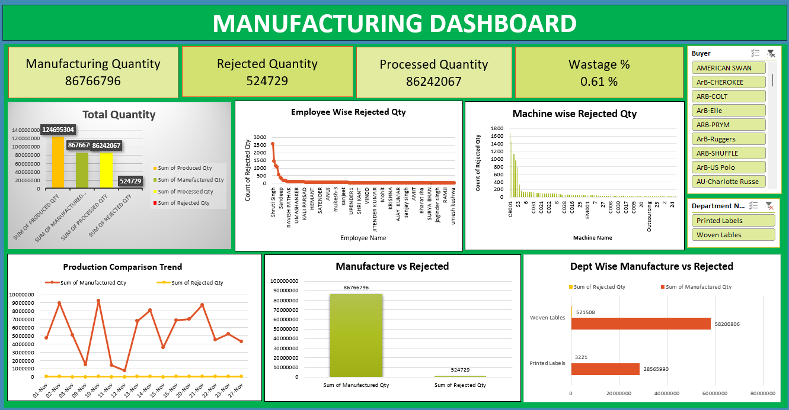
Excel Dashboards :
03

Slide 6
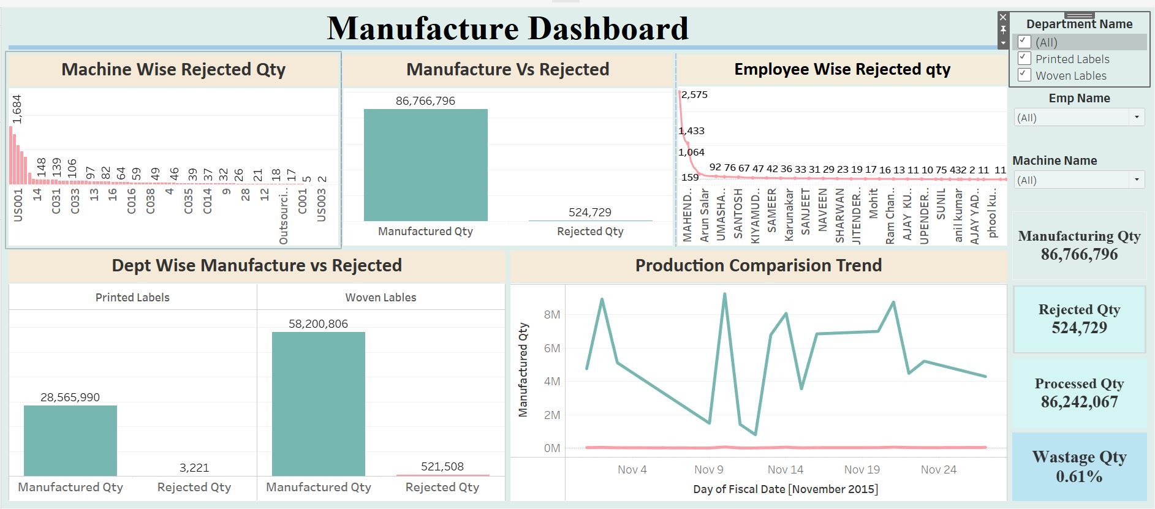
Tableau Dashboards :
03

Slide 7
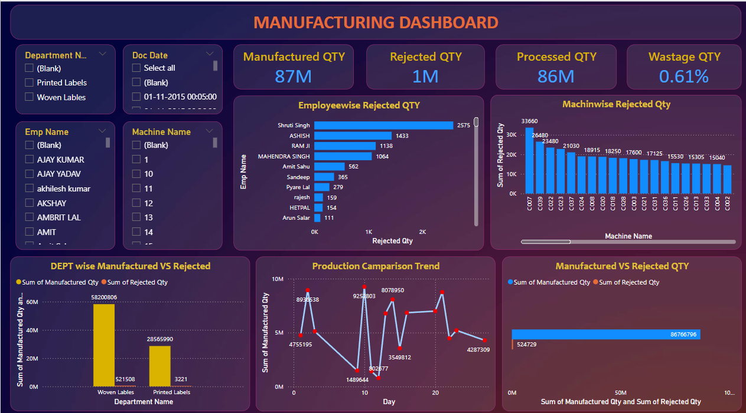
PowerBI Dashboards :
03

Slide 8
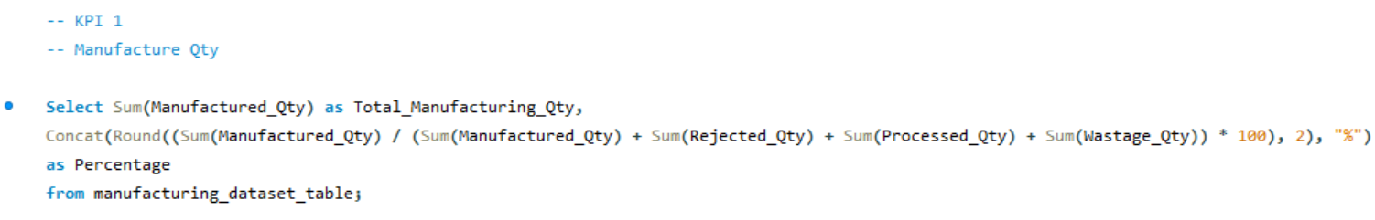
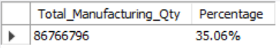
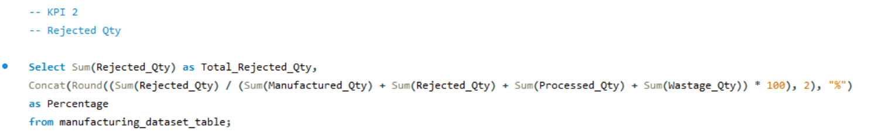
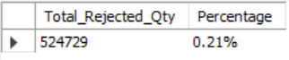
MySQL Syntax :
04

Slide 9
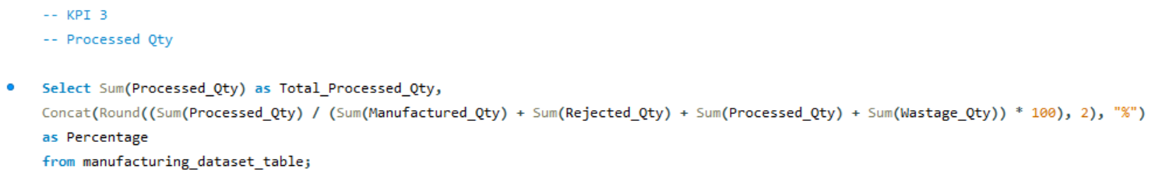
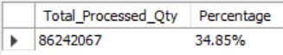
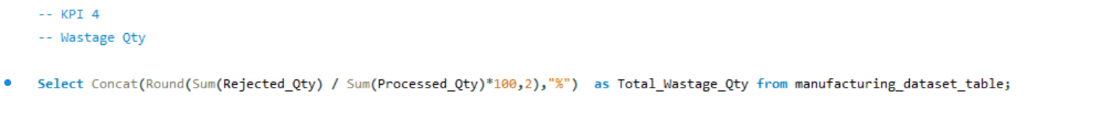
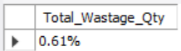
MySQL Syntax :
04

Slide 10
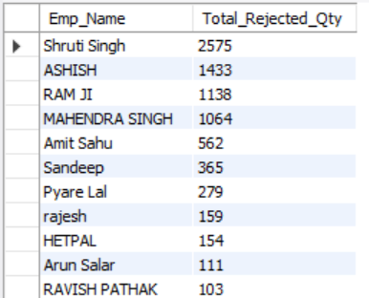
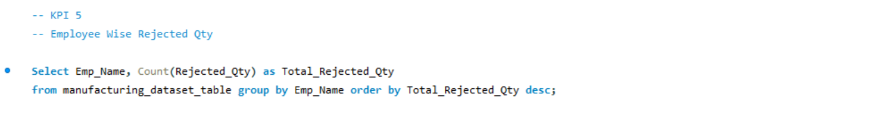
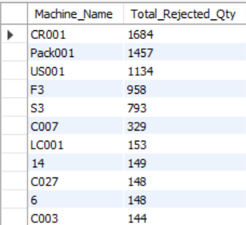
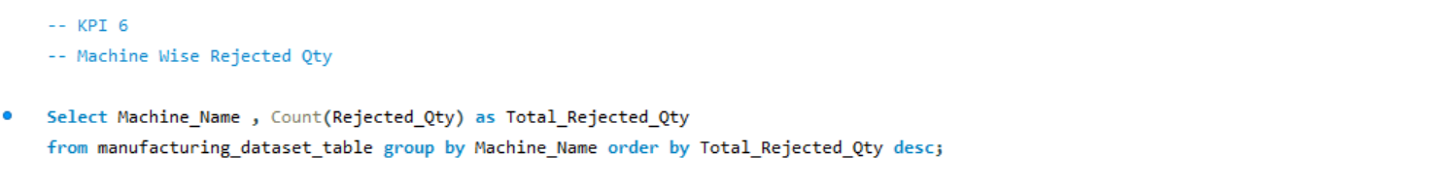
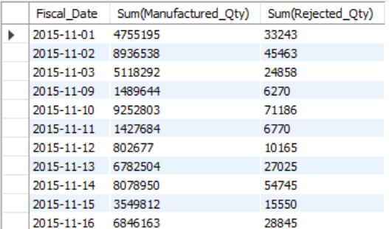
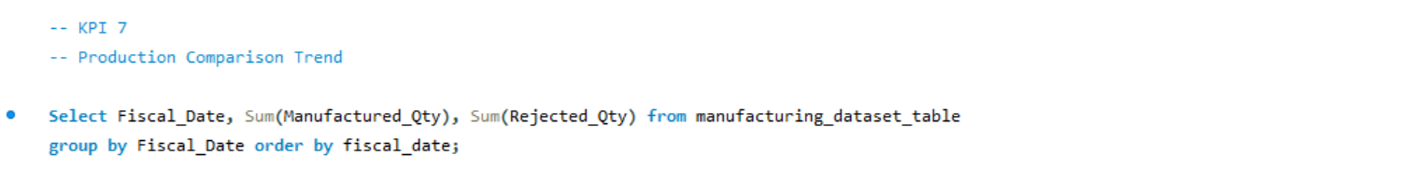
MySQL Syntax :
04

Slide 11
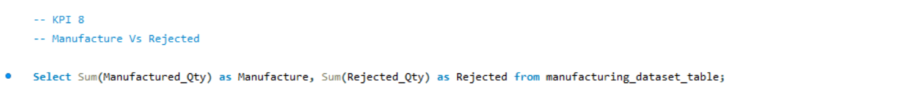
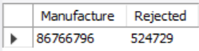
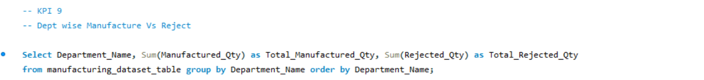
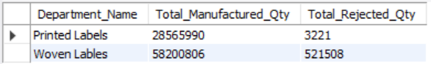
MySQL Syntax :
04

Slide 12
Key Takeaways :
05
Production Metrics Tracking: The dataset captures essential production metrics such as Manufacture Quantity, Rejected Quantity, Processed Quantity, and Wastage Quantity, facilitating a comprehensive overview of manufacturing operations.
Quality Control Insights: Monitoring rejection rates, both Employee-Wise and Machine-Wise, provides valuable insights into product quality, enabling proactive measures to address issues and enhance quality control procedures.
Operational Efficiency: Analyzing production comparison trends and department-wise manufacture versus rejected quantities helps identify operational inefficiencies, allowing for targeted optimization of processes and resources.
Data-Driven Decision Making: The dataset empowers stakeholders to make informed decisions by providing accurate and timely data through Tableau and SQL results analysis, enabling strategic planning and performance enhancements.
Performance Monitoring: Through the dashboard, stakeholders can monitor daily, weekly, and monthly production metrics to track performance, set targets, and drive continuous improvement in manufacturing processes.
Cost Optimization: By reducing wastage and minimizing rejection rates, the dataset offers opportunities for cost savings and resource optimization, contributing to overall operational efficiency and financial sustainability.
Enhanced Quality Control: The focus on employee-wise and machine-wise rejected quantities enables a more granular approach to quality control, leading to improved product quality and customer satisfaction.
The manufacturing dataset and dashboard present a wealth of information crucial for optimizing production processes, enhancing quality control, and facilitating data-driven decision-making to drive efficiency and success in manufacturing operations.

Slide 13
THANK YOU

